Slide 1


STRUCTURE
By, Ms. P.olynia V. Kharbuli
Dept. of Computer Sc.
St. Anthony’s College, Shillong

Slide 2
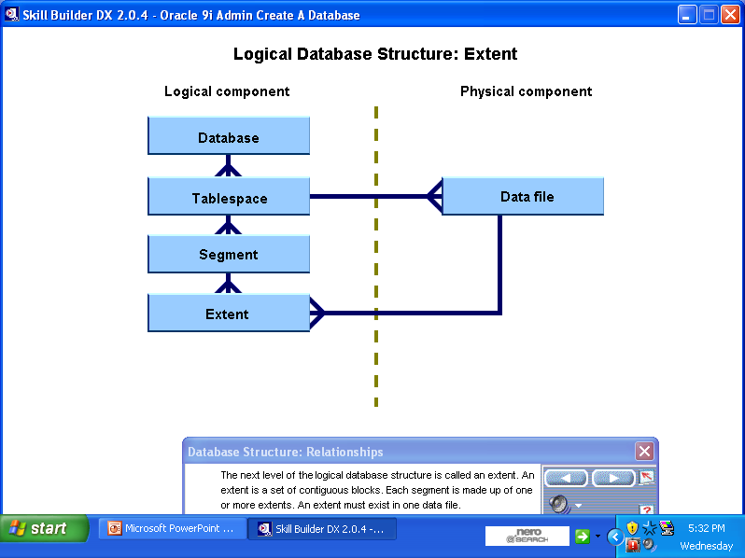
Database Structure
An Oracle database is a collection of data treated as a unit.
The database has Logical and Physical Structure

Slide 3
Levels of Logical Database Structure
Data Block: At the finest level of granularity, Oracle stores data in data blocks (also called logical blocks or pages). One data block corresponds to a specific number of bytes of physical database space on disk.
Extent: The next level of logical database space is an extent. An extent is a specific number of contiguous data blocks allocated for storing a specific type of information.
Segment: The level of logical database storage in between tablespace and extent is called a segment. A segment is a set of extents, each of which has been allocated for a specific data structure and all of which are stored in the same tablespace. For example, each table's data is stored in its own data segment
Tablespace: Each tablespace in an Oracle database consists of one or more files called data files, which are physical components of a database. The size of a tablespace is the size of the data files that constitute the tablespace. A tablespace can have multiple schemas, each of which is associated with a user

Slide 4
Database Objects
An Oracle database is a collection of objects called a Schema
Schema is a logical container for database objects created by a particular user
Schema objects include
Tables
Views
Sequences
Stored Procedures
Triggers
Synonyms &
Indexes

Slide 5
About the Database Objects
A table is a basic unit of data storage in an Oracle database. Every table has a unique name and each column must have a name, a datatype, and a width(or scale and precision in the case of numeric data).
A view is a derived table that is a representation of the data in one or more tables. A view is sometimes referred to as a “stored query”. Views do not actually contain or store data. Instead, they derive their data from the tables on which they are based.
A sequence can be used to automatically generate a serial list of unique numbers for a numeric column in a table. It is typically used to automatically generate unique primary key values for values the primary key column even when multiple users are inserting rows into the table at the same time

Slide 6

About the Database Objects
A stored procedure or function is a set of SQL and PL/SQL statements that form executable unit to perform a specific task.
Triggers are specialized procedures that are automatically executed as a result of an insert in, update to, or delete from a table.
A synonym is an alias for a table, view, sequence or procedure.
Indexes are created for columns in a table to improve data retrieval speeds.

Slide 7


